Slide 1
Lesson 18 – Homework review

Slide 2


Be developer-independent

Slide 3
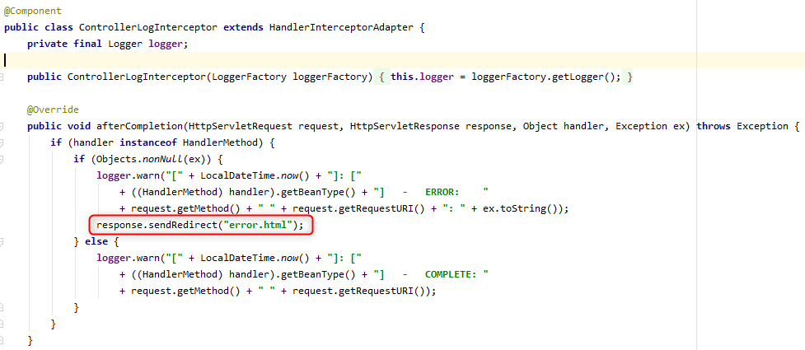
Logger should only log

Slide 4

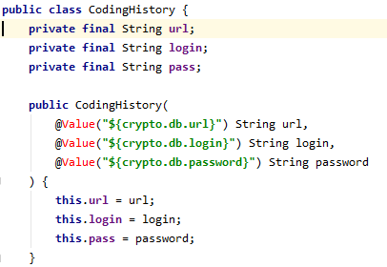
Do not Repeat Yourself

Slide 5
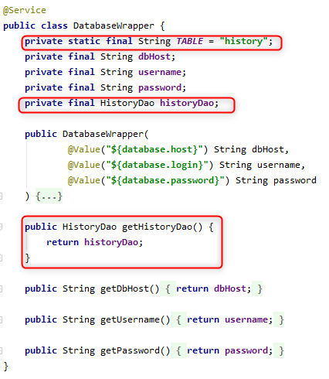
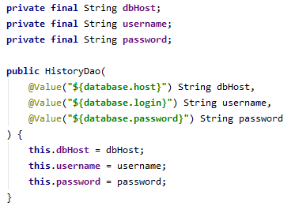
Follow the Law of Demeter

Slide 6
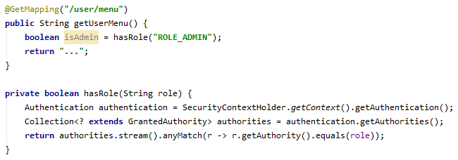

Depend on required info

Slide 7
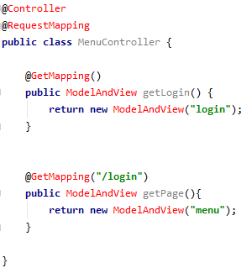
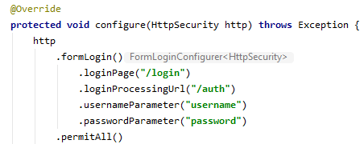
Remove useless code

Slide 8
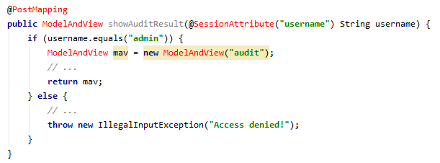

Verify access by Spring Security

Slide 9
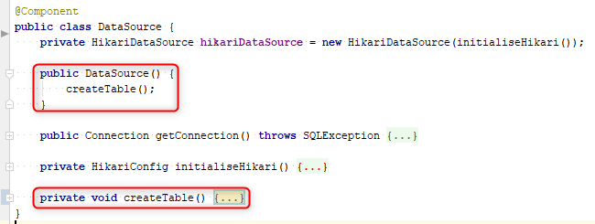
Do not create table in DataSource\DAO constructor

Slide 10
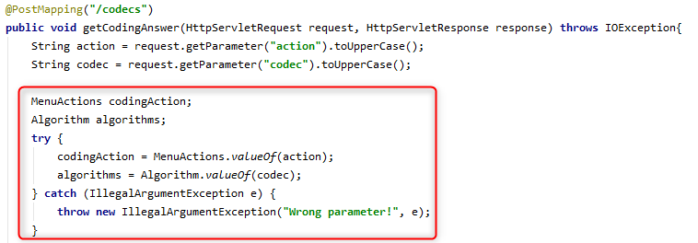
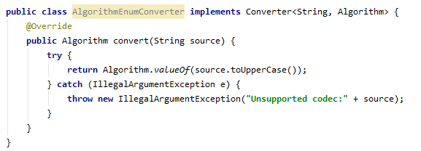
Eliminate duplicated manual work

Slide 11
Apply recommendations from personal feedbacks before starting next homework

